Slide 1
TRANSFORMING DEVELOPMENT
LEJLA SADIKU
OPEN DATA SPECIALIST
UNDP ISTANBUL REGIONAL HUB
PROJECT BOARD MEETING, 12.12.2017

Slide 2
CONTENT
Project Goals
Project Approach
Project Progress
Learning
Financial Overview
•

Slide 3
PROJECT GOALS
Public sector institutions in the ECIS region enhanced knowledge and skills to use data for good governance and social impact;
Citizens in the ECIS region enabled to generate and use data that could strengthen design and delivery of a wide range of public services;
Regional and national entities, leaders and groups enabled to learn from each other, collaborate and share experience; and
National counterparts and citizens enabled to apply a range of alternative financing mechanisms for the benefit of policy-making and public service delivery.

Slide 4
APPROACH
•Country Level Interventions
•Present a problem and a willing partner
•Proof/Redefine the problem based on user research (validate: are we solving the right problem)
•Identify and open the relevant data to address the problem, identify new sources of data (digital and non)
•Engage citizens in developing solutions
•Enhance institutional capacity to integrate design thinking in problem solving, determine new avenues for citizen-government relations, and establish measurable results to interventions.
••Enable learning and sharing.

Slide 5
DESIGNING WITH PEOPLE
Public Service Evaluation Tool
Ethnographic research with pre-retirement people
Mobile phones do not work for this target group
Information flows from person-to-person
7 chambers across the country
MiLab conducting ethnographic research; Photo Credit: MiLab

Slide 6
DESIGNING WITH PEOPLE
Open Contracting in the Public Procurement Commission
70% delays in reviewing complaints
2 days of iteration to understand the clog in the system
$$$ for businesses & agencies

Slide 7
DESIGNING WITH PEOPLE
DataLex Armenia
150,000 court cases filed in 2016
Established Smart Search DataLex
Improve predictability, transparency and efficiency of legal aid

Slide 8
DESIGNING WITH PEOPLE
Air Pollution in Skopje
Heating choices correlate with the education levels
1.3% of the citizens select their heating based on how much it pollutes
Correlation between waste treatment & air pollution
From 1 city, endorsed by 20 now
Notes:
Energy efficiency is very concerning issue – wall and roofs insulation / not the windows
Heating choice does not correlate with the income level but with the education level
Only 1.3% of the citizens select their heating means based on how much it pollutes
Correlation between waste treatment problem and air pollution

Slide 9
DESIGNING FOR SCALE
In Serbia & Tajikistan, improving performance reporting of local governments
Piloting with 2-3 local governments, potential to scale nationally
Relevance of understanding the political economy

Slide 10
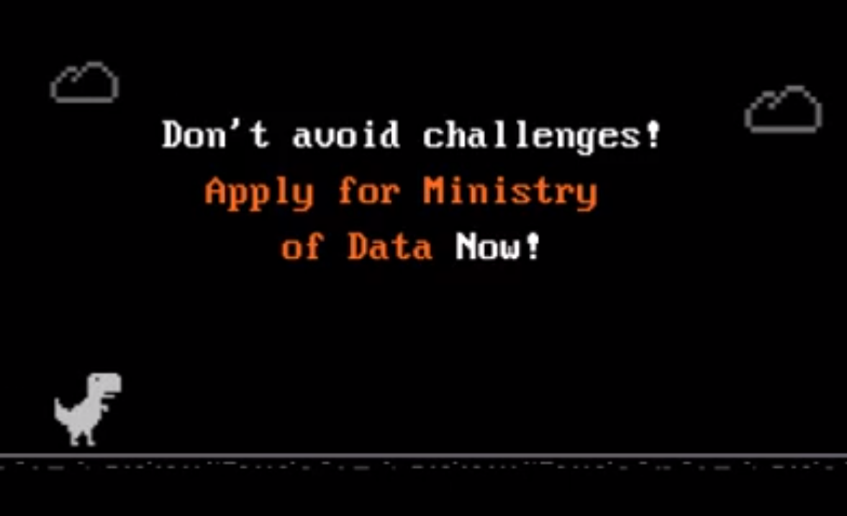
ECO-SYSTEM BUILDING
High engagement with community in Western Balkans & Black Sea
Application number increased by 40% in WB
Winners linked up to other actors for scaling
Collaboration with private sector in the Western Balkans sub-region

Slide 11
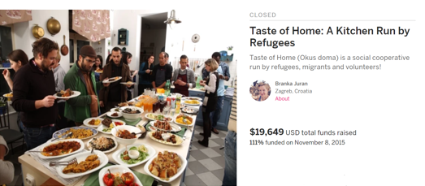
Working with 45 governments, UNDP offices and other partners
Raised over 5,5 mil $
A trip advisor Citizenergy; for green energy in more than 20 countries (investments exceeded 35 mil EUR)
Two Social Impact Bonds projects in Serbia and Belarus
Blockchain pilots in Serbia, Moldova, Armenia and Tajikistan (in the pipeline: Ukraine)
Combining crowdfunding and blockchain with Solar Coin Foundation and Sun exchange
Forecast Based Financing for floods in Bosnia

Slide 12
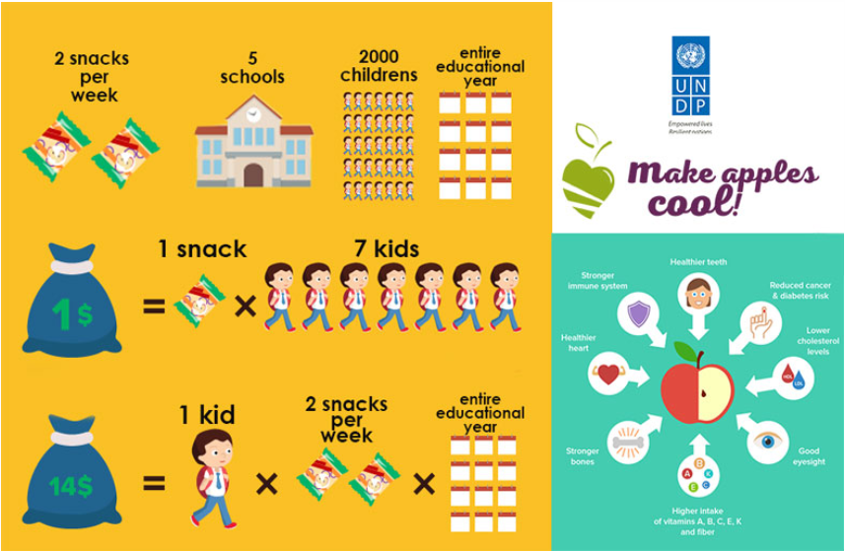
UNDP Moldova campaign (Make Apples Cool) scaled up activities from 3,500 kids to over 350.000 kids at the national level
The Global Crowdfunding Academy UNDP Istanbul 2016, Cairo, Kiev and Bosnia and Herzegovina 2017 have mobilized over $1.000,000
The Crowdfunding Academy Croatia 2015, 2016, 2017 most of them on Indiegogo) to date has completed more than 20 campaigns with mobilized over $300.000.
Crowdfunding Academies to support entrepreneurs in Ukraine and Bosnia and Herzegovina

Slide 13
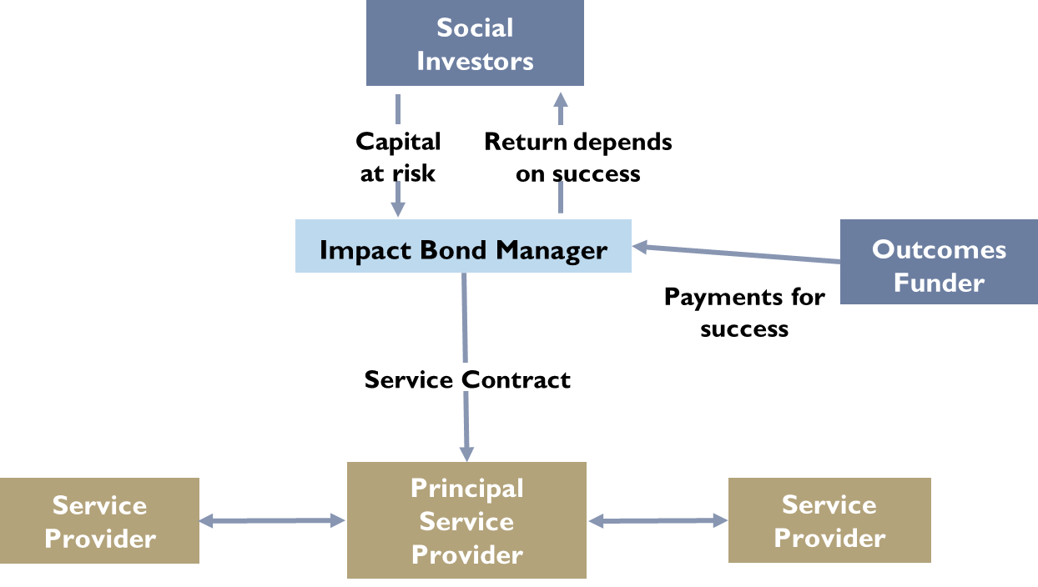
Growing portfolio to change the focus from activities to results and impact
€5m Social Impact Bond aimed to be launched in early 2018 in Serbia to tackle the youth unemployment
Others in design phase: rhino protection DIB in Africa, road safety SIB in Montenegro

Slide 14
LEARNING
Country Level Interventions
Regional Initiatives
Possibility for regional replication
Necessity to link-up to broader reform processes
Investment in design
External on demand expertise
Time-related demands
High demand for regional & cross-regional collaborative platforms
Investment required in R&D in emerging areas
High demand for data and digital literacy

Slide 15
FINANCIAL OVERVIEW
 | Funding (2017) | Balance (2017)
Output 1 | 241,971 | 42,079
Output 2 | 202,833 | 7,515
Output 3 | 222,096 | 516
Output 4 | 162,321 | 1,815
TOTAL | 829,221 | 51,925

Slide 16
OUTSTANDING ISSUES
Agreement on any outstanding balance
Decision on transfer of assets (1 laptop)
Decision for the operational closure of the project

Slide 17
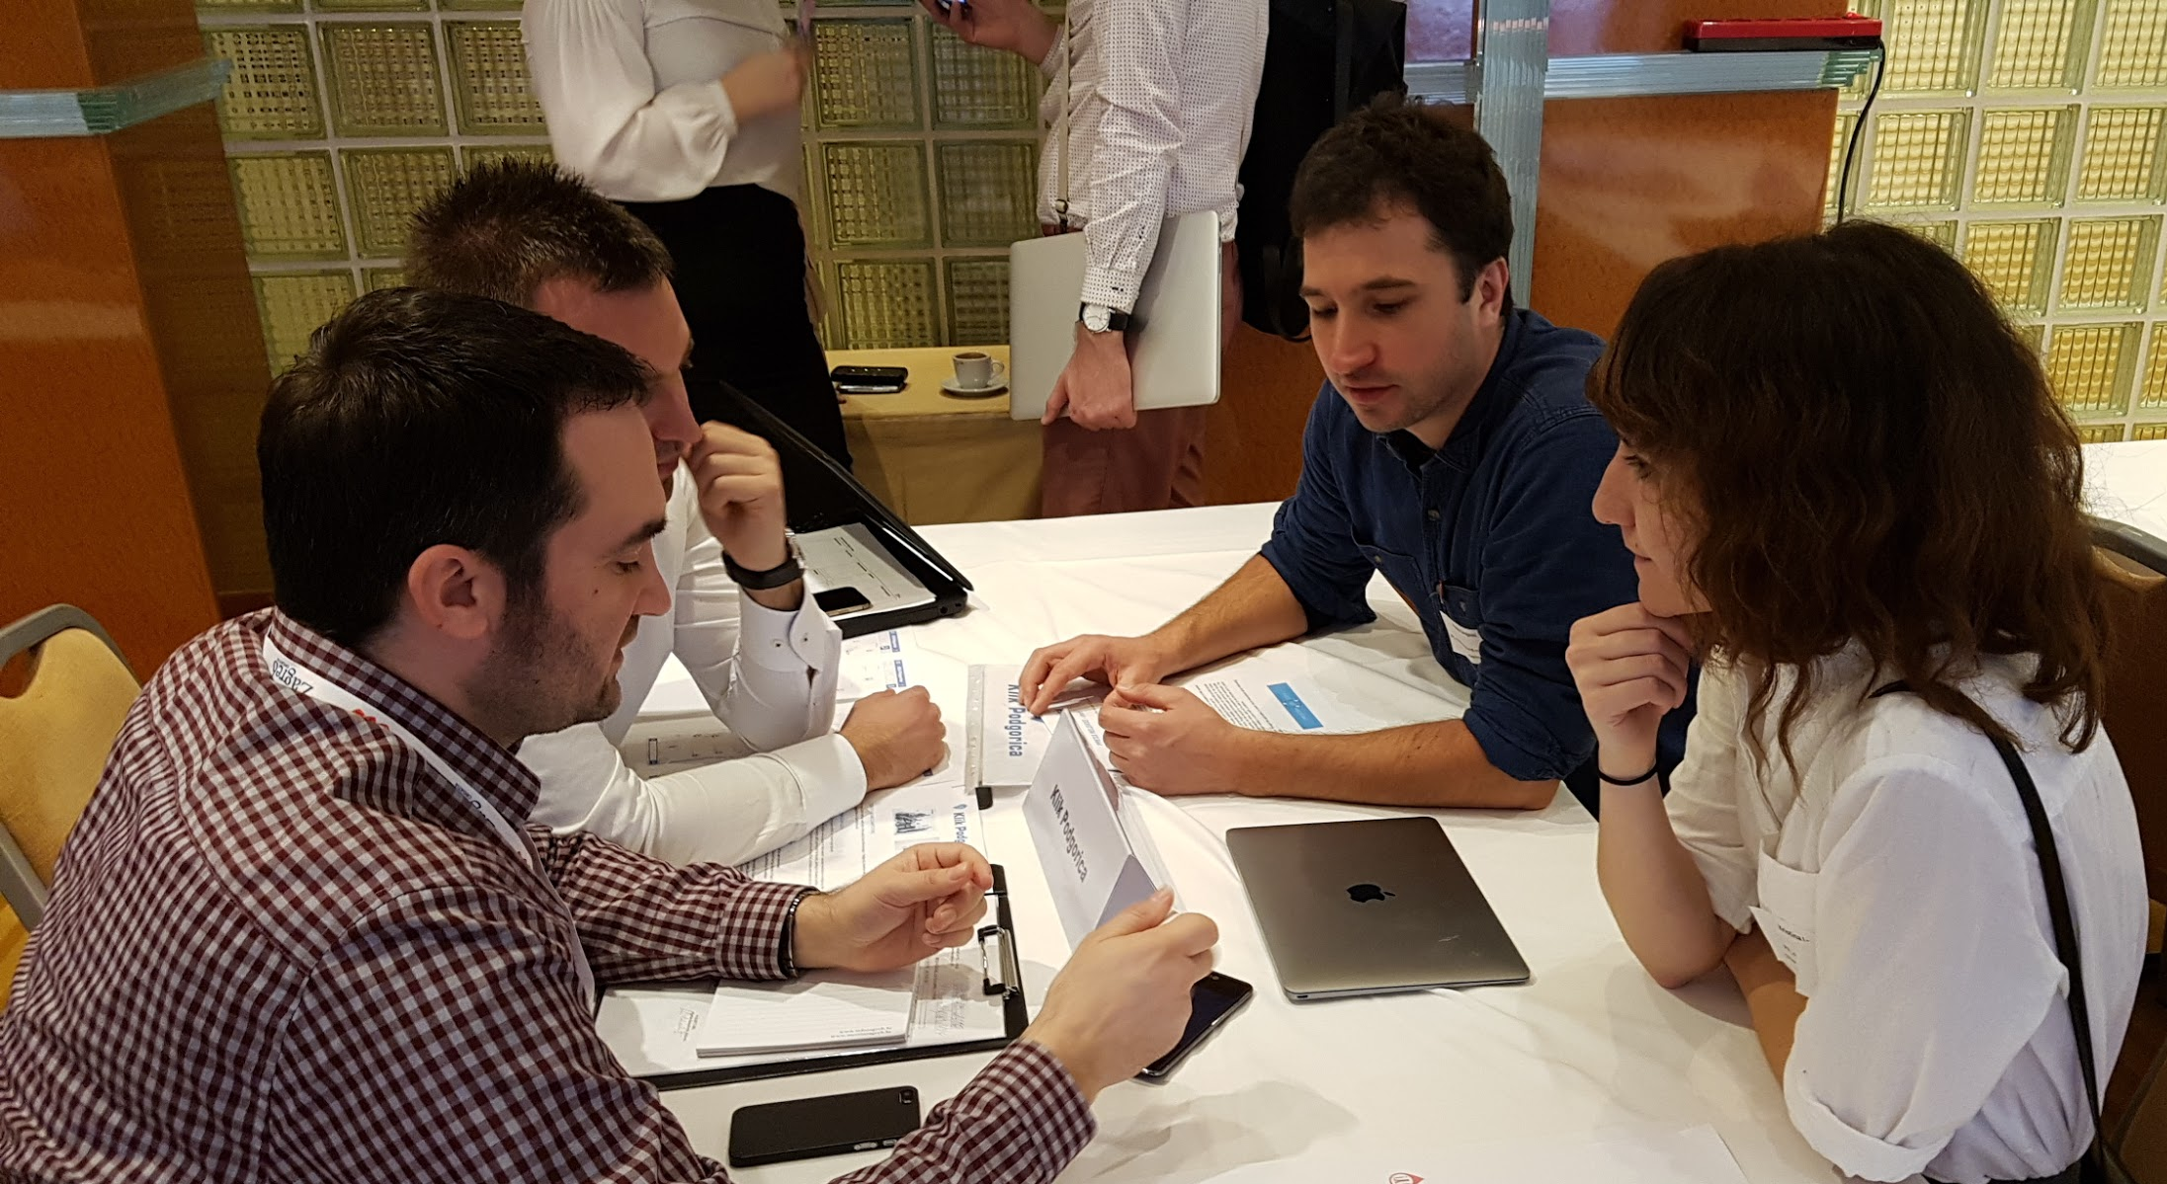
Questions?
Thank you for listening.

